Slide 1
Session 9
NAD1001: INTRODUCTION TO ARCHITECTURAL DESIGN

Slide 3
Contract Document
Contract documents include:
the completed contract form
the specification
the drawings the bill of quantities
other documents, either listed in the contract (MW‐1) or which the owner is contractually obliged to provide to the contractor (AS4000).

Slide 4
Types of Contracts
Residential contracts
Commercial contracts
Different contracts will result in different drawing requirements.

Slide 5
Document Classification
Drawings
Other document
The classification of drawings and procedures:
1)Design(or concept) drawing: at design stage
i) Schematic drawing: a preliminary design drawing, sketch or diagram showing in outline form.
ii) Development drawing: a design drawing developed to show the building and site as envisaged by the designer.

Slide 6
Document Classification
The classification of drawings and procedures:
2) Production stage drawings: at production stage
i) Location drawing
ii) Construction (or structural) detail drawing
iii) Component drawing
iv) Assembly drawing
Think about what functions of these types of drawings

Slide 7
Document Classification
Other documents:
1) Specification
2) Schedule
3) Bill or schedule of quantities
4) Engineering specifications and/or other reports
5) Other documents that may be required

Slide 8
Residential Contract
Home Building Act
Rights of homeowners, builders, and contractors
Warranties
Payments
Deposit
Insurance
Matters relate to residential construction work

Slide 9
Commercial Contract
Shops
Hotels
Space for a business
Additional permits documents maybe required

Slide 10
Contract Terms
Lump sum contracts
Cost plus contracts
Design Build
Public Private Partnership
Can you identify the pros and cons of each type?

Slide 11
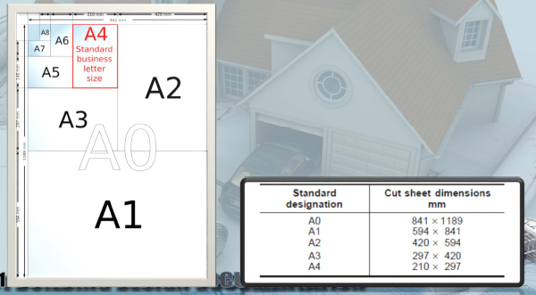
Paper Size of Documentation
A3 size is used for?
A2 size is used for?
What about A0 and A1?

Slide 12
Activity: Practice Plot Documentation Sheets from Revit

Slide 13
Session 9
Visualisation

Slide 14
Visualisation
Apart from documentation drawings, other visualisation drawings are required, such as rendered drawings.
Let’s take a look at different visualisation works, such as render and collage…
This is usually required for conceptual early state presentation and final outcome of the design visuals…

Slide 15
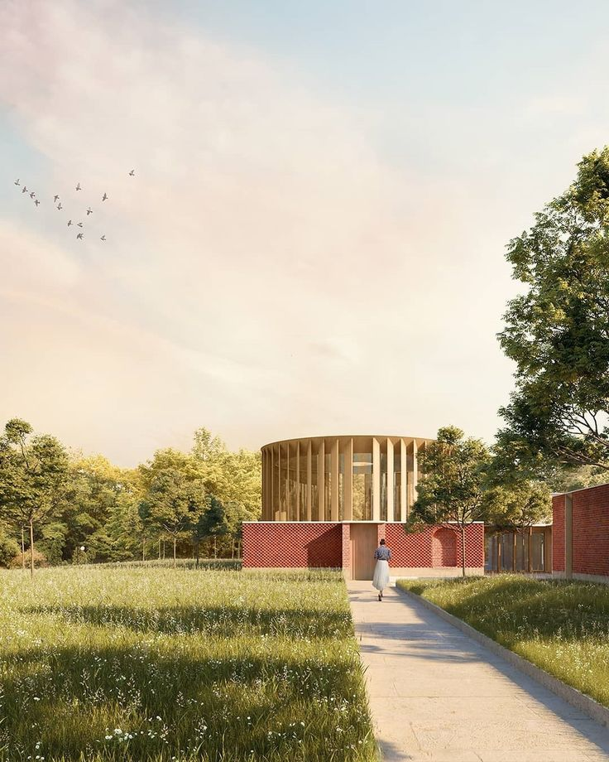
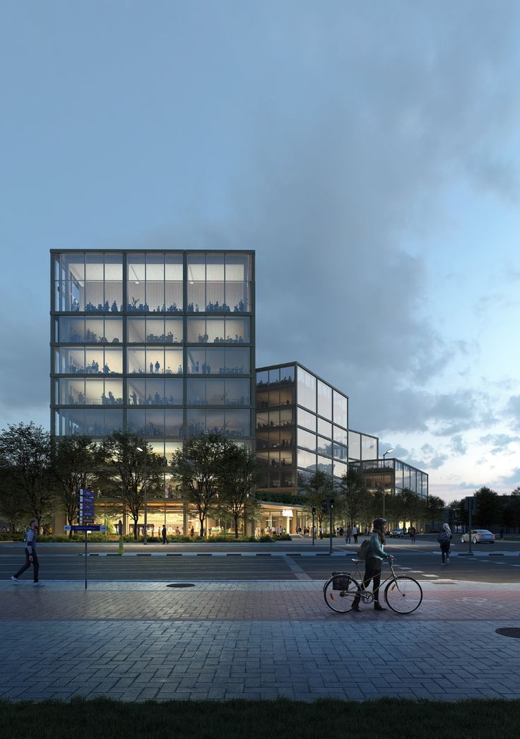
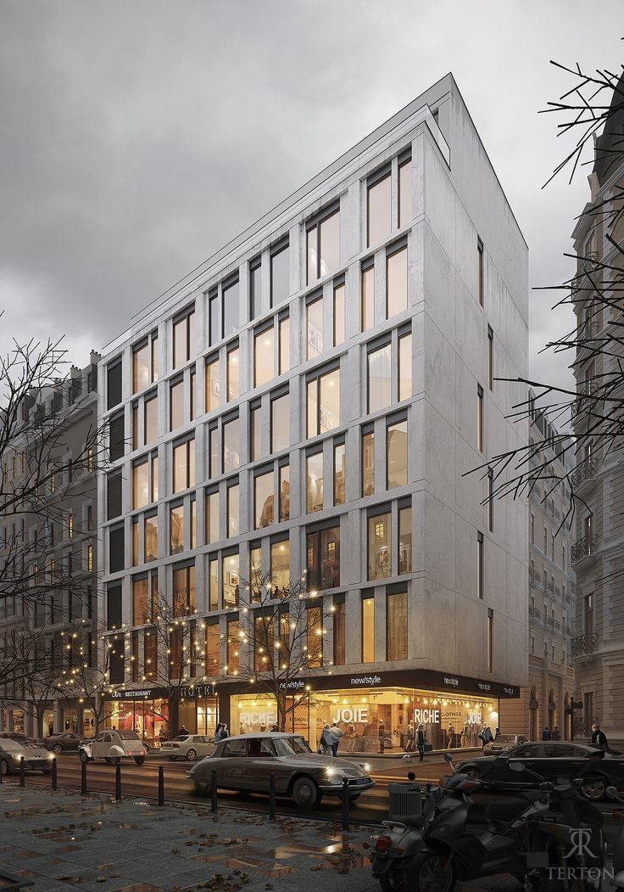
Rendering in Different Styles
Source: ArchDaily

Slide 16

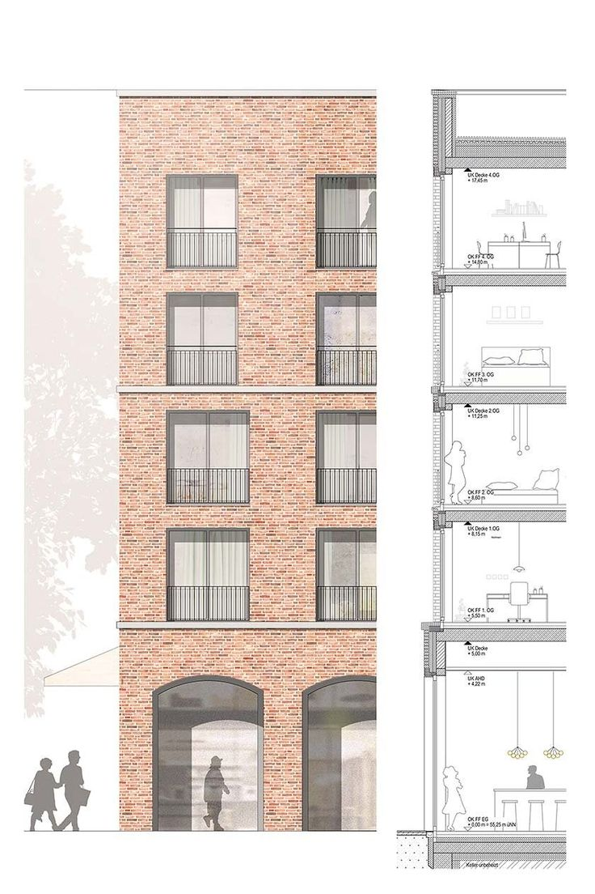
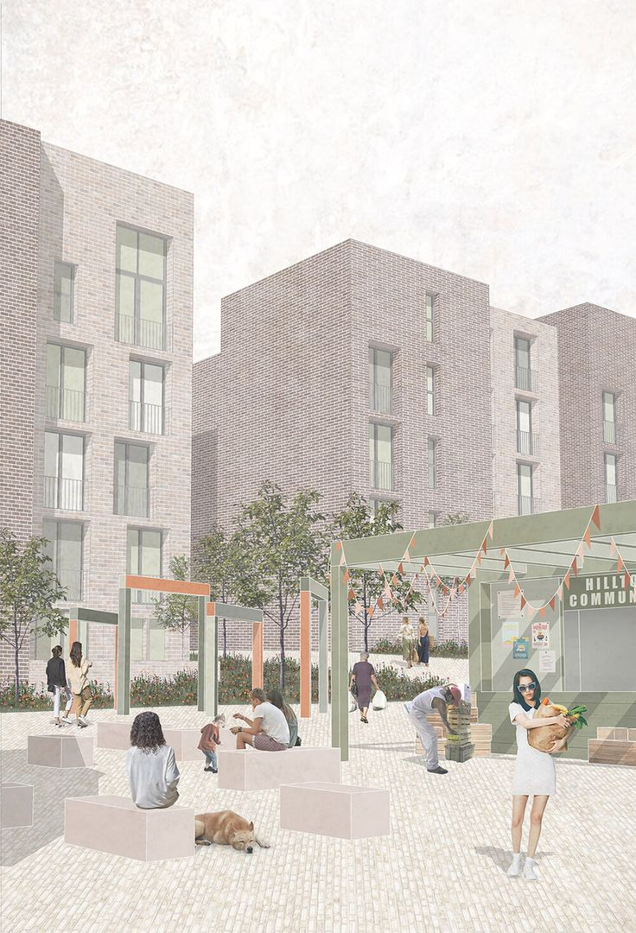
Collage Examples
Source: ArchDaily

Slide 17
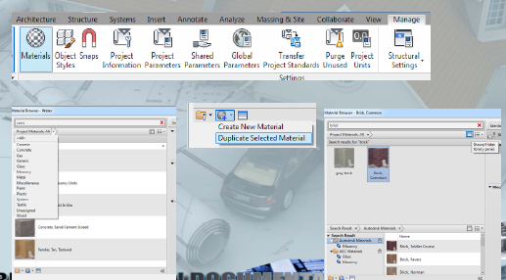
The Use of Software

Slide 18
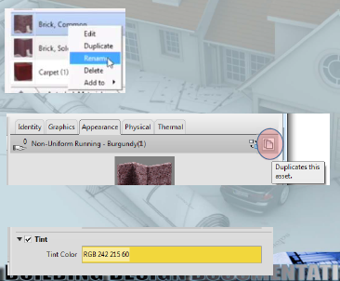
Change Material Setting

Slide 19
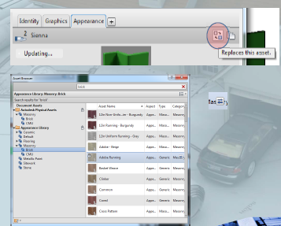
Editing a Texture

Slide 20
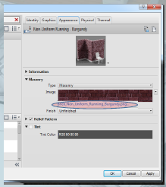
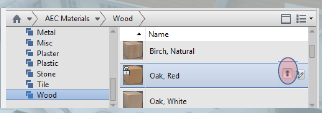
Creating a Customised Texture
Add a New Material from Library to Document

Slide 21
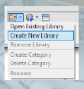
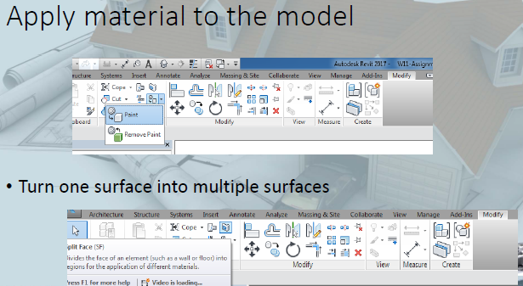
Creating a New Library and Apply Material

Slide 22
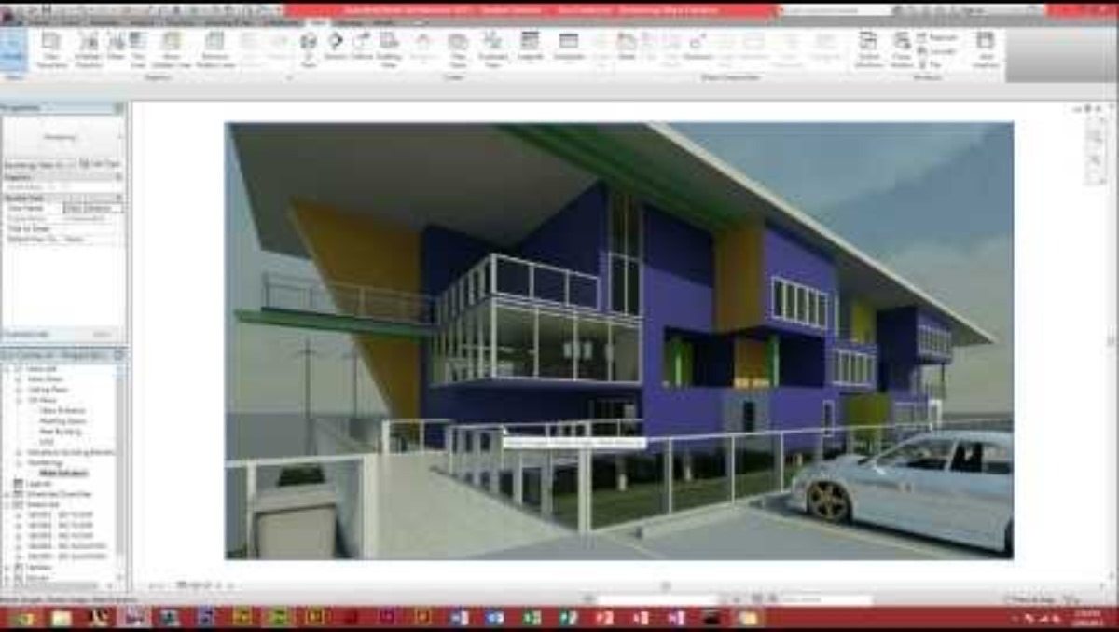
Revit Rendering Basics
Instructor to demonstrate camera setting and rendering basics – required for final project.

Slide 23

Walkthrough in Revit
Instructor to demonstrate walkthrough basics – optional for final project.

Slide 24
Reference
Arch Daily. (2025). Arch Daily Image. https://www.archdaily.com/

Slide 25
Thank you
Questions?

